Slide 1

Verification of the Non-Negativity and Even Symmetry Properties of the Power Spectral Density. ~ RANDOM PROCESS
24BML0069 – Surya Pratap Singh
24BEC0066 – Srajan Gupta

Slide 2
PURPOSE
This project explores and verifies the fundamental properties of the Power Spectral Density (PSD) of a Wide-Sense Stationary (WSS) random process. Specifically, it focuses on non-negativity and even symmetry. These properties are first proven analytically using the Wiener–Khinchin theorem and then validated through MATLAB simulations. An exponentially decaying autocorrelation function is used due to its simplicity and practical relevance. Both analytical and simulation results confirm that the PSD is always non-negative and symmetric about zero frequency.

Slide 3
INTRODUCTION
The Power Spectral Density (PSD) describes how the power of a signal is distributed across different frequencies. For a real-valued WSS random process, the PSD is defined as the Fourier transform of its autocorrelation function, according to the Wiener–Khinchin theorem. Two essential properties of PSD are non-negativity and even symmetry. Non-negativity arises because power cannot be negative, while even symmetry results from the real-valued nature of the signal. This presentation demonstrates both properties through theory and simulation.

Slide 4

MATHEMATICAL MODEL
We consider a real-valued Wide-Sense Stationary (WSS) random process $X\left(t\right)$. A process is WSS if its statistical properties do not change with time, and its autocorrelation depends only on time difference $τ$.
The autocorrelation function (ACF) of the process is defined as:
$$R_{X}\left(τ\right)=𝔼\left[X\left(t\right)X\left(t+τ\right)\right]$$
For this study, we assume an exponentially decaying autocorrelation function:
$$R_{X}\left(τ\right)=e^{−a∣τ∣}$$
where:
$a>0$is the decay constant.
$τ$is the time lag.

Slide 5

POWER SPECTRAL DENSITY
Using Wiener–Khinchin theorem:
$$S_{X}\left(f\right)=\int_{−∞}^{∞}{e^{−a∣τ∣}}e^{−j2πfτ}dτ$$
Solving the integral gives:
$$S_{X}\left(f\right)=\frac{2a}{a^{2}+{\left(2πf\right)}^{2}}$$
This is a Lorentzian spectrum, symmetric around $f=0$.
The simulation uses parameters such as:
$a=2,$Sampling frequency $f_{s}=1000 \text{Hz}$, FFT length $N=4096$, Duration $T=4.096 \text{s}$
These ensure accurate numerical computation of PSD.

Slide 6
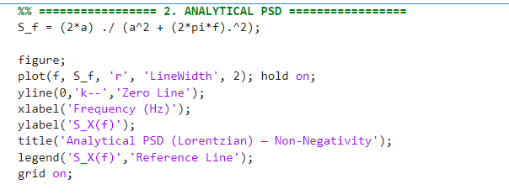

MATLAB CODE FOR NON NEGATIVITY
Let $X_{T}(t)=X(t)⋅rect(t/T)$ be the time-windowed version of the process, with Fourier transform $𝒳_{T}(f)$. By definition:
$$S_{X}(f)=\lim_{T→∞} \frac{E \left[|𝒳_{T}(f)|^{2}\right]}{T}$$
Since $|𝒳_{T}(f)|^{2}≥0$ (magnitude squared is always non-negative), and the expectation $E[⋅]$ and limit preserve non-negativity:
$$S_{X}(f)≥0 ∀ f∈ℝ$$
Let $X_{T}(t)=X(t)⋅rect(t/T)$ be the time-windowed version of the process, with Fourier transform $𝒳_{T}(f)$. By definition:
$$S_{X}(f)=\lim_{T→∞} \frac{E \left[|𝒳_{T}(f)|^{2}\right]}{T}$$
Since $|𝒳_{T}(f)|^{2}≥0$ (magnitude squared is always non-negative), and the expectation $E[⋅]$ and limit preserve non-negativity:
$$S_{X}(f)≥0 ∀ f∈ℝ$$
|
6
Audio Noise Cancellation using Wiener Filter | Surya Singh | VIT Vellore

Slide 7
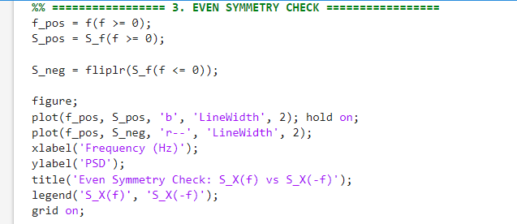
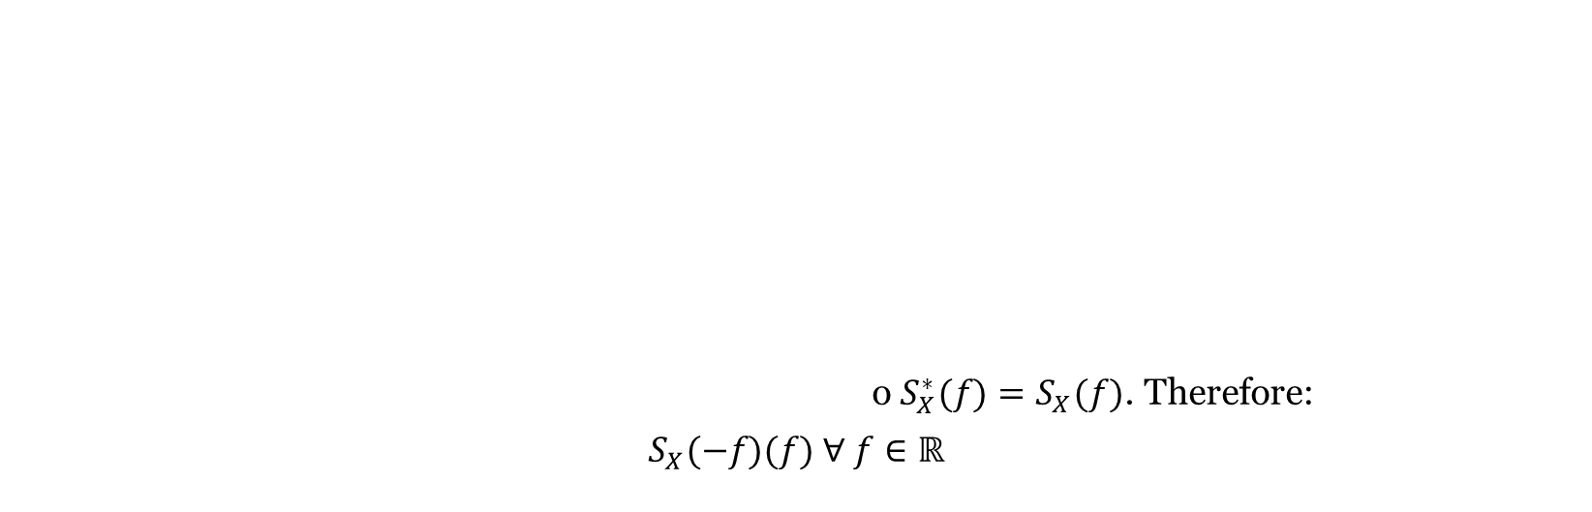
MATLAB CODE FOR EVEN SYMMETRY CHECK
$$\text{Since} X(t) \text{is} \text{real}\text{-}\text{valued} \text{and} \text{WSS}\text{, }R_{X}(τ) \text{is} \text{a} \text{real} \text{and} \text{even} \text{function}\text{: }R_{X}(−τ)=R_{X}(τ)\text{. }\text{Evaluate} S_{X}(−f)\text{:}$$
$$S_{X}(−f)=\int_{−∞}^{∞}{ }R_{X}(τ) e^{+j2πfτ} dτ={\left[\int_{−∞}^{∞}{ } R_{X}(τ) e^{−j2πfτ} dτ\right]}^{∗}=S_{X}^{∗}(f)$$
$$\text{Since} R_{X}(τ) \text{is} \text{real}\text{, }S_{X}(f) \text{is} \text{real}\text{-}\text{valued}\text{, }\text{so} S_{X}^{∗}(f)=S_{X}(f)\text{. }\text{Therefore}\text{:}$$
${ S}_{X}(−f)=S_{X}(f) ∀ f∈ℝ$o $S_{X}^{∗}(f)=S_{X}(f)$. Therefore:
$$S_{X}(−f)(f) ∀ f∈ℝ$$
7
Audio Noise Cancellation using Wiener Filter | Surya Singh | VIT Vellore

Slide 8
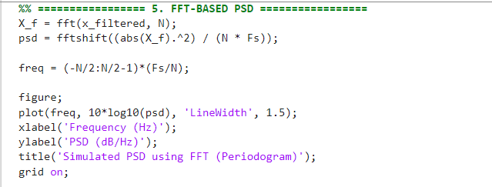
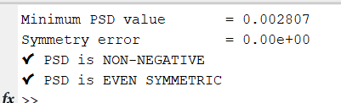
CONSOLE OUTPUT:
8
Audio Noise Cancellation using Wiener Filter | Surya Singh | VIT Vellore

Slide 9
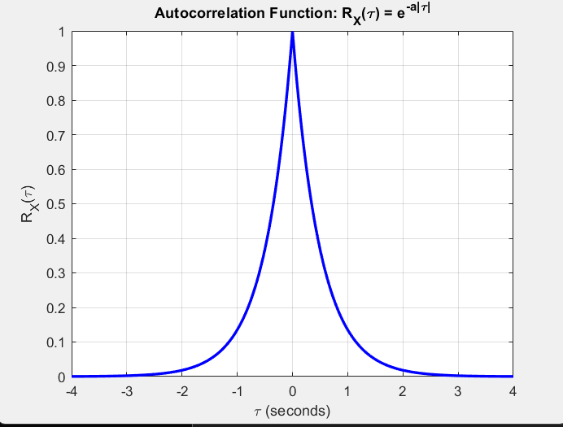
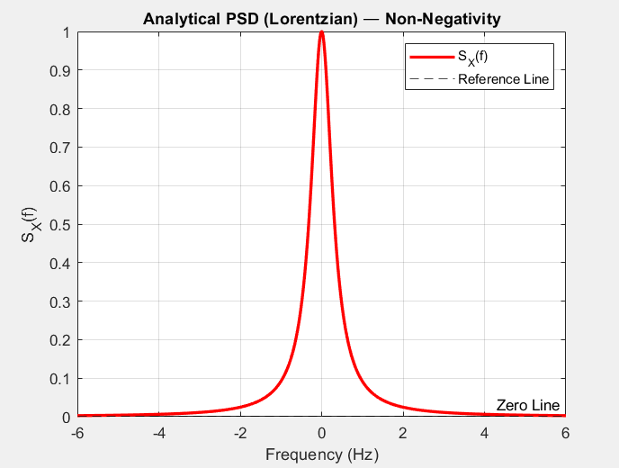
MATLAB GRAPHS
GRAPH 1 GRAPH 2

Slide 10
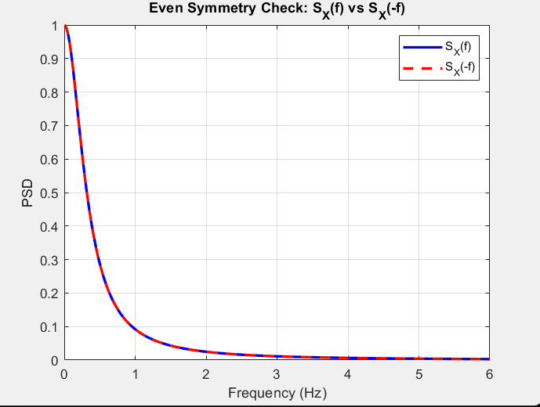
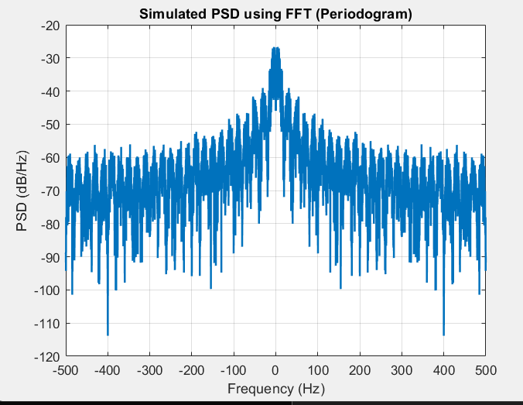
GRAPH 3 GRAPH 4

Slide 11

OBSERVATIONS
The autocorrelation function $R_{X}\left(τ\right)=e^{−a∣τ∣}$is real, even, and symmetric about $τ=0$, confirming the process is WSS.
The ACF shows maximum value at $τ=0$and decays exponentially as $∣τ∣$increases, indicating loss of correlation over time.
The analytical PSD
$$S_{X}\left(f\right)=\frac{2a}{a^{2}+{\left(2πf\right)}^{2}}$$
is always positive, confirming the non-negativity property.
The PSD has a peak at zero frequency $\left(f=0\right)$, meaning most signal power is concentrated at low frequencies.
The analytical PSD curve is smooth and symmetric, clearly showing:
The symmetry check graph shows perfect overlap of $S_{X}\left(f\right)$and $S_{X}\left(−f\right)$, with negligible error, confirming even symmetry mathematically.
The FFT-based PSD (periodogram) also shows symmetry about zero frequency and maintains non-negative values, validating the properties numerically.
Although the FFT PSD contains random fluctuations due to finite data and noise, its overall shape follows the Lorentzian spectrum, matching the theoretical result.

Slide 12

CONCLUSION
This project successfully verifies the fundamental properties of the Power Spectral Density (PSD) of a Wide-Sense Stationary (WSS) random process, namely non-negativity and even symmetry. Using the Wiener–Khinchin theorem, the PSD was derived from the autocorrelation function $R_{X}\left(τ\right)=e^{−a∣τ∣}$, resulting in the Lorentzian form $S_{X}\left(f\right)=\frac{2a}{a^{2}+{\left(2πf\right)}^{2}}$. Theoretical analysis clearly shows that the PSD is always non-negative and symmetric about zero frequency. These properties were further validated through MATLAB simulations using both analytical and FFT-based approaches. The graphical results confirmed that the PSD remains positive and exhibits perfect symmetry, even under practical conditions with finite data. Although minor fluctuations were observed in the simulated PSD, the overall behavior closely matched the theoretical model. Hence, the study establishes that these properties are inherent to WSS processes and are consistently observed in both theory and real-world signal analysis.

